Slide 1

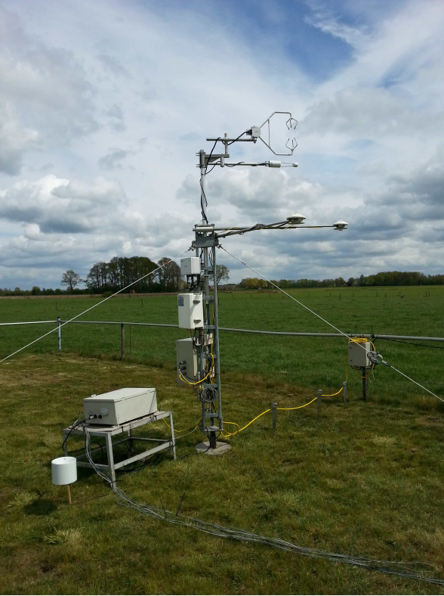
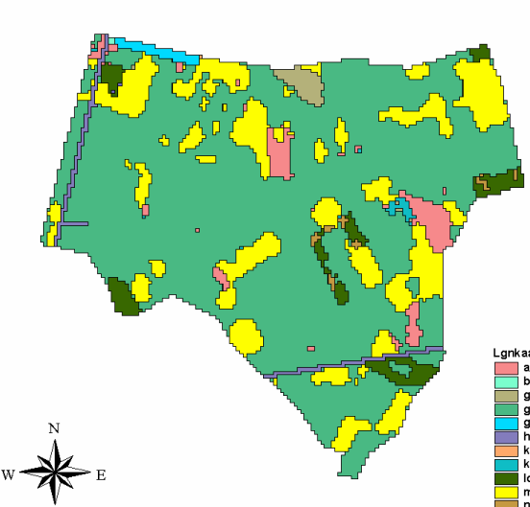
Atmospheric fluxes - 1
June 2, 2020

Slide 2
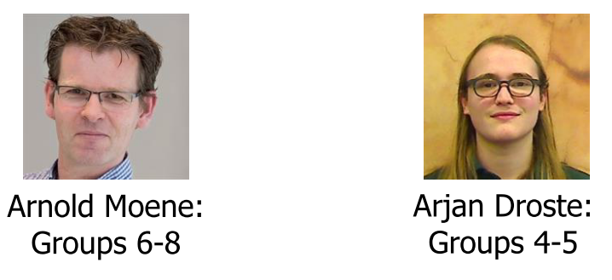
Organization
8:30-8:45 - Introduction
8:45-12:00 - Work on the exercise
Groups split in 2 subgroups, 2 lecturers (via Slack)
Groups 1-4: Arnold
Groups 5-8: Arjan
Before you submit, first discuss results with lecturer
This afternoon: new exercise
Groups 1-4
Groups 5-8

Slide 3
Data-analysis fluxes 1: Final goals
Catchment-wide actual ET
Reference ET with
Makkink
Priestley-Taylor
Penman-Moneith (FAO)

Slide 4
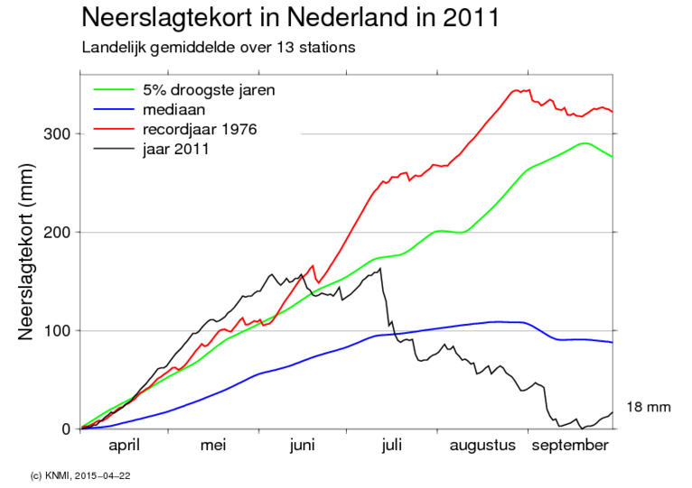
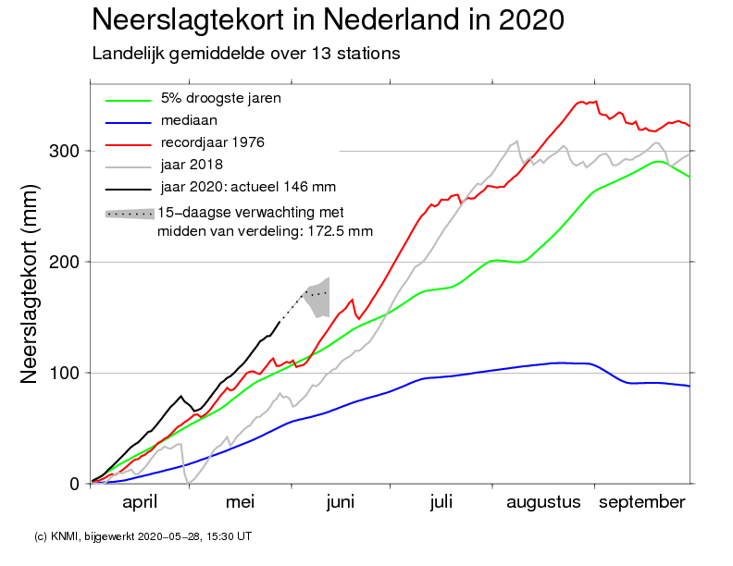
Current year + detailed data from 2011
Understand processes: EC + KNMI data from 2011
Quantify current year: KNMI data 2020

Slide 5
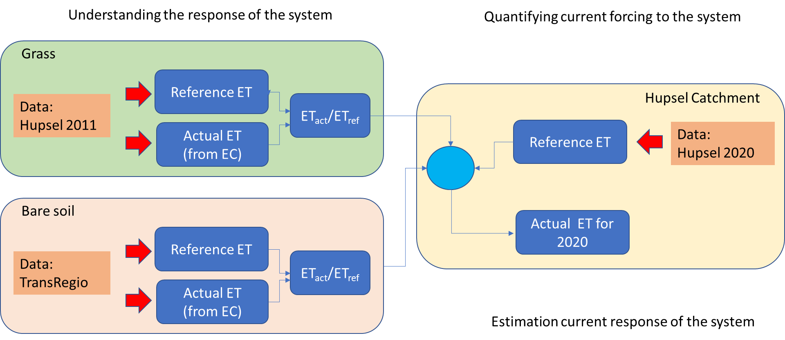
How to get to actual ET for 2020?

Slide 6
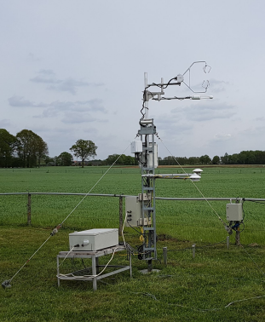
How to get to actual ET for 2020?

Slide 7
How to get to actual ET for 2020?

Slide 8
How to get to actual ET for 2020?

Slide 9
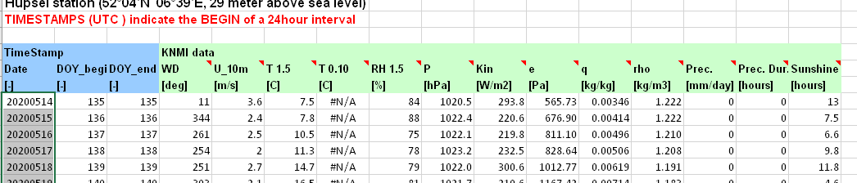
Your data
Standard meteo

Slide 10
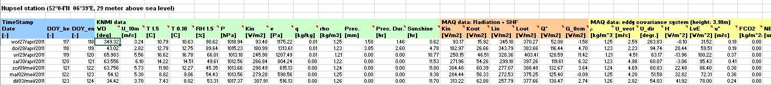
Your data
Standard meteo
Standard meteo
Luxurious flux data

Slide 11
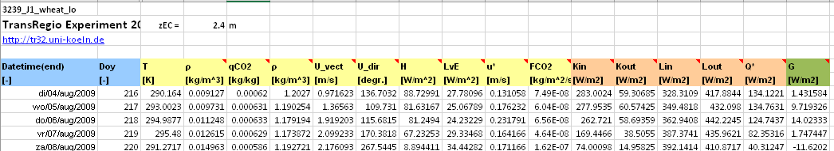
Your data
Standard meteo
Standard meteo
Luxurious flux data
Luxurious flux data

Slide 12
Data analysis: reference ET (2020)
Compute reference ET:
Makkink
Priestley-Taylor
Penman-Monteith (FAO method, but measured Q*-G)
Analyse differences and correspondences

Slide 13
Output
Basin-wide ET -> keep for water balance exercise !
Preformatted excel file: results_meteo_1_YOURNAME.xlsx
Rename the file
Fill in your results
First discuss results with lecture
Submit to Brightspace
I will compute some group-mean variables (e.g. basin-wide ET for water balance)

